Slide 1
Group 02 Bomberman
1901040002 – Vu Van An 1901040155 – Le Anh Phan

Slide 2
TABLE OF CONTENTS
1. Introduction
2. Components
4. Conclusion
3. Result
5. Q&A
Introduction to Bomberman project
Components in making Bomberman
Summary project and discussion
The completion of Bomberman project

Slide 3


01
Introduction
Introduction to Bomberman and how it is being built

Slide 4
1. Introduction
Bomberman is a classic action-puzzle game where players navigate grids, place bombs to destroy obstacles and enemies, and aim to survive each level.
The game is being built using Java, with an object-oriented approach, where key components like the game entities, player, enemies, and bombs are represented as classes. The game utilizes algorithms for player movement, enemy pathfinding, and bomb explosions.
The purpose of this project is to synthesize the knowledge learned in the Java Software Development course, including multi-threaded programming, meta-programming, GUI development with Swing, network programming, functional programming, and JDBC

Slide 5
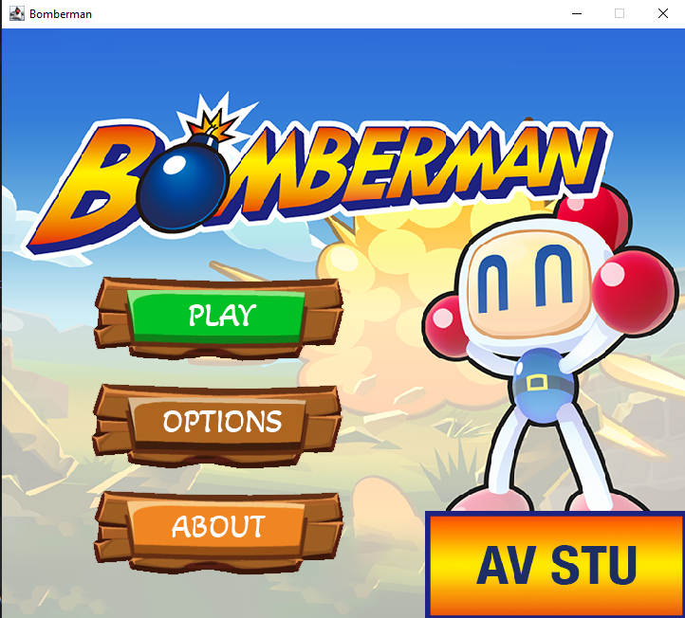
1. Introduction
Starting…

Slide 6
02
Components
Components in making Bomberman

Slide 7
Components
Audio
Entities
Graphic
JDBC
Input
GUI
Handle game audio
Game entities
Game graphic
Databse connection
Handle keyboard input
Graphical User Interface

Slide 8
Components
Level
Board Render
Common Variables
Game Render
Bomberman -main
Manages the game board's state, rendering, and updates, serving as a controller for entities like characters, bombs, explosions, and the level.
Level information
Used to define common constants and shared resources for the Bomberman game.
Main rendering and game management class in a Bomberman game
Store main class to run program

Slide 9
audio / Audio

Slide 10
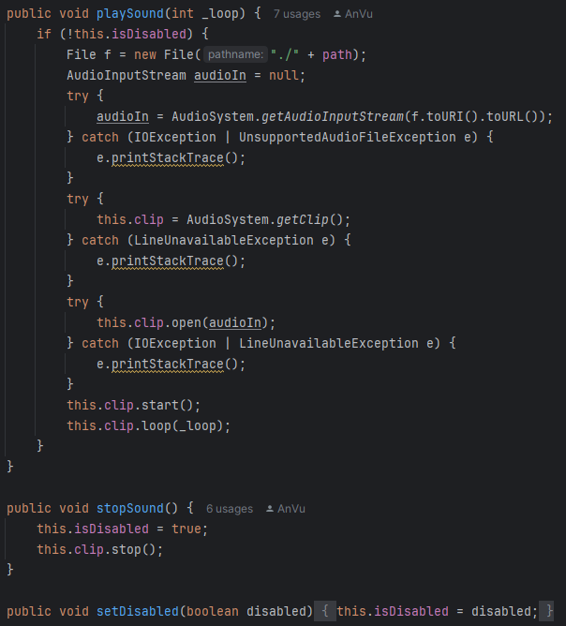
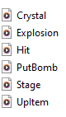

audio / Audio
The audio file saved in the res package will be called up when starting the game. The background sound is the only sound that is repeated from the start of the menu, followed by during gameplay, and will end when player exits game. Players can mute the sound after entering the game through the mute icon implemented by the stopSound() function.

Slide 11
Entities
Sub package bomb
Entity
Message
Sub package
character
Sub package
tile
Handle bomb and explosion logic.
Handle player movement, actions, and enemies behavior.
Handle environment like obstacle, brick, wall, surface, power-ups,
Animated Entity
Layer Entity
The class provides a basic animation mechanism for any game entity that inherits from it.
The Entity class is an abstract base class. It provides common properties and methods that all game entities will inherit.
Handling stacked game objects, such as when a destructible tile is covered by another object like a bomb or a power-up.
The Message class is a specialized type of Entity in the Bomberman game that represents temporary on-screen text messages

Slide 12
entities/bomb/Bomb

Slide 13
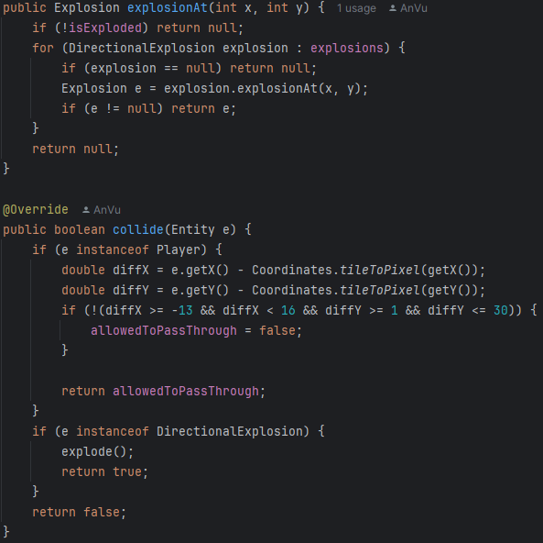

entities/bomb/Bomb
The first step we always have to do is declare the bomb's properties such as explosion time and time to place the next bomb. But the most important thing is still handling the logic of where to place the bomb and handling the collision of the bomb

Slide 14
entities/bomb/Explosion

Slide 15
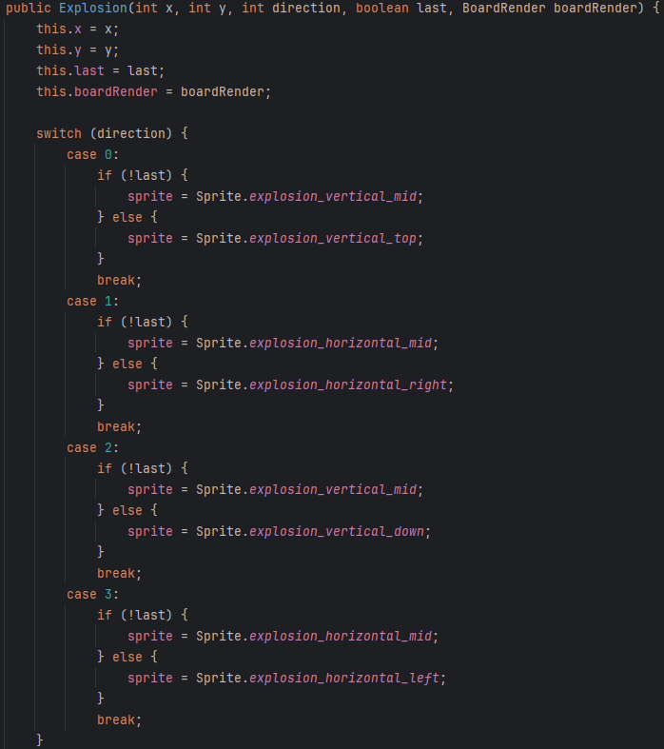

entities/bomb/Explosion
Class Explosion handles the directions of bomb explosion, top, bottom, left, right. In case some of the directions are blocked by an unbreakable or recently broken object, the explosion direction will be in the remaining direction. For example, middle - top, middle - right, etc,...

Slide 16
entities/character/Character

Slide 17
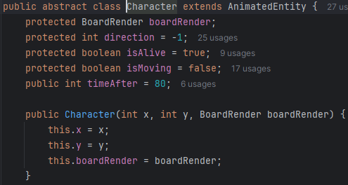
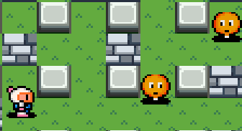
Entities/characer/Character
The character class declares common variables used by other classes such as the Player class and the Enemy class

Slide 18
entities/character/Player

Slide 19
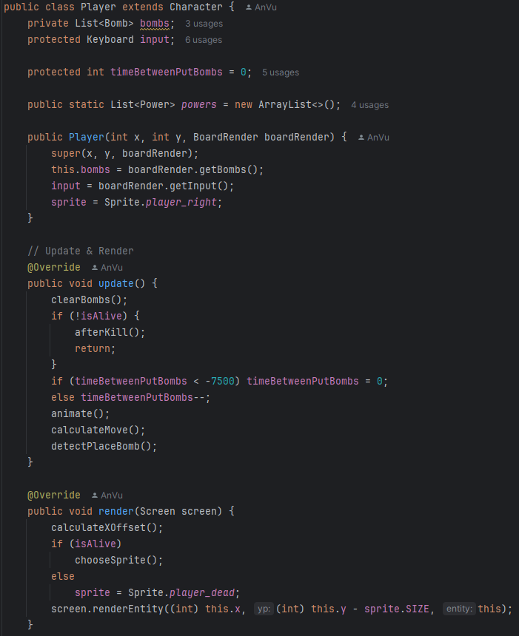

Entities/characer/Player
This Java class Player is part of a Bomberman game implementation, where it represents the player character controlled by the user. Here we will initialize and build properties for the player including the player's features in the game such as character image, movement, actions.

Slide 20
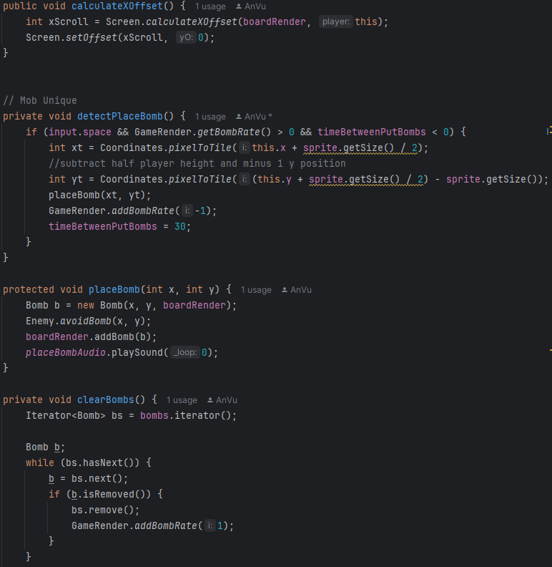
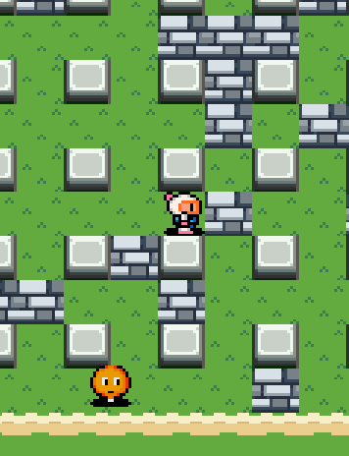

Slide 21
entities/character/enemy/algorithm

Slide 22
Algorithm
Algorithm
BFS
HighAlgo
MediumAlgo
Abstract base class for defining different movement behaviors for enemies in the game.
Implements the Breadth-First Search (BFS) algorithm to find the shortest path in a 2D grid (matrix) for the Bomberman game.
Uses Breadth-First Search (BFS) to determine the shortest path to the player and then decides the direction the enemy should move.
Attempts to move the enemy towards the player either vertically or horizontally, depending on random choice.

Slide 23
Algorithm
SimpleAlgo
Point
Randomly selects a direction for the enemy to move, making it the simplest form of movement logic.
Used for representing a location in a 2D grid.

Slide 24
entities/character/enemy/algorithm/BFS

Slide 25
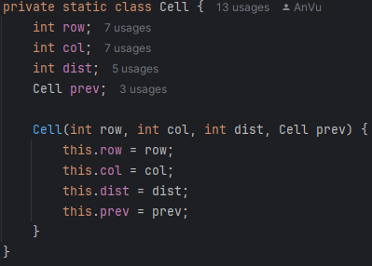
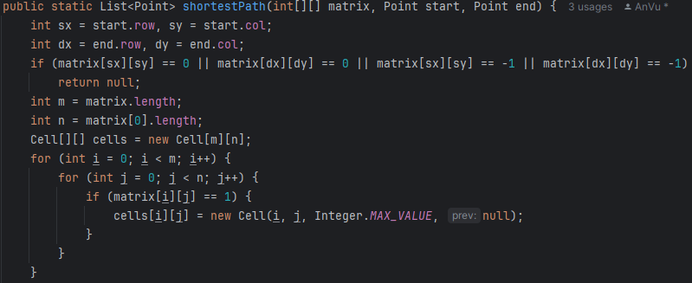
This code prepares data for the pathfinding process of the BFS algorithm. It:Check if the start and end points are valid.Initialize the matrix of traversable cells as Cell objects, storing the position, distance, and previous cell information of each cell in the matrix.Now the cells matrix is ​​ready so that BFS can traverse the cells, update the distance and construct the shortest path from the start point to the end point.
Row, col, distant and prevent point
Get the starting point and ending point
Check the validity of the start and end points. Initialize the matrix cell (Cell). Initialize cells in the cells matrix.

Slide 26
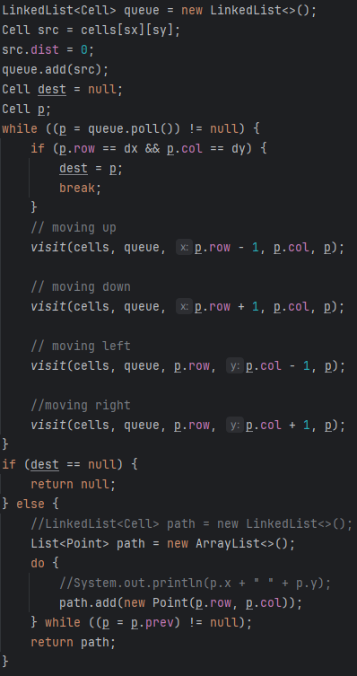
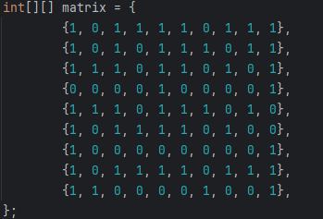
The square is the player, the circle is the enemy, the yellow line is the enemy using the BFS algorithm to find the target, the target here is the player. Where 0 represents the path the enemy can take and 1 represents the obstacle.

Slide 27
entities/character/enemy/algorithm/HighAlgo

Slide 28
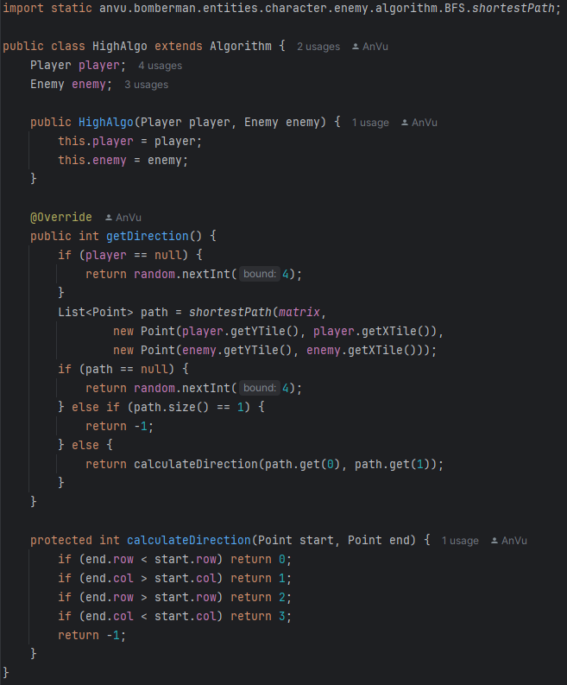
Entities/characer/enemy/algorithm/HighAlgo
HighAlgo is the most sophisticated algorithm in this project for enemies that can avoid obstacles and will find the closest path to the player. It inherits from the BFS algorithm implemented in the previous class

Slide 29
entities/character/enemy/algorithm/MediumAlgo

Slide 30
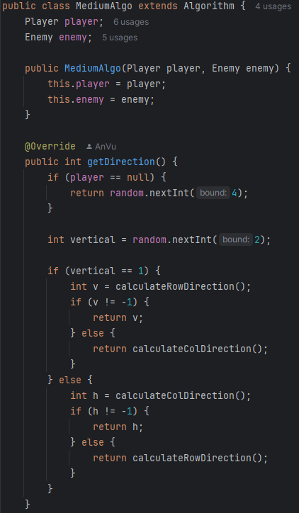
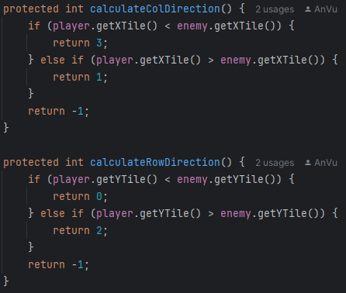
MediumAlgo possesses a less complex algorithm for normal enemies, they have the ability to avoid obstacles and can find the player but the distance for them to develop is very short.

Slide 31
entities/character/enemy/algorithm/SimpleAlgo

Slide 32
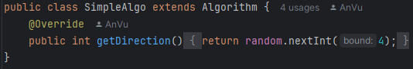
Entities/characer/enemy/algorithm/SimpleAlgo
SimpleAlgo is for the least developed enemies, they only come to you when there are no obstacles or are not affected by objects at all. They have function getDirection() {return random.nextInt(4);}

Slide 33
entities/character/enemy/Enemy

Slide 34
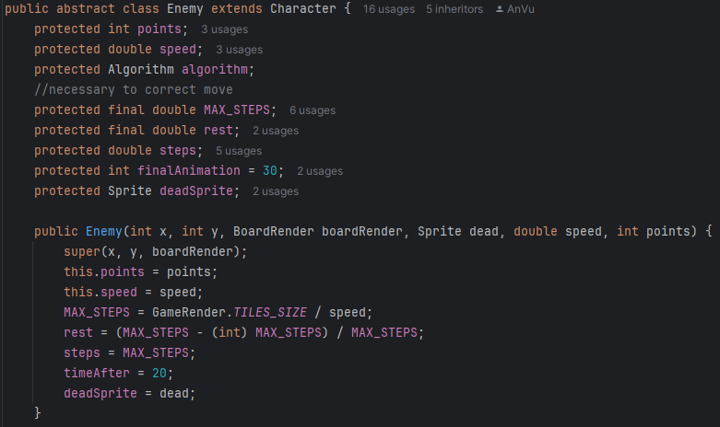
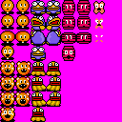
Enemies also possess a number of classes identical to the player, however, they have different expressions and attributes depending on the type of enemy and the algorithm applied.

Slide 35
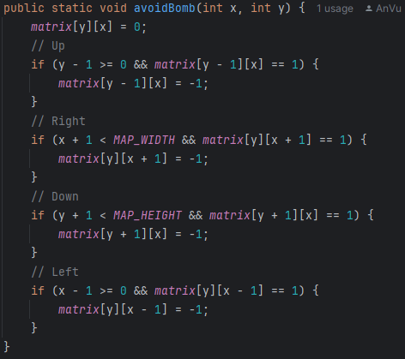
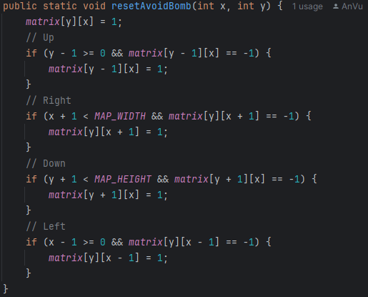
Most have the ability to avoid bombs and will automatically detect themselves in a safe zone, meaning that after the bomb explodes, the time to avoid the bomb will be reset.

Slide 36
entities/tile/destroyable/brick

Slide 37
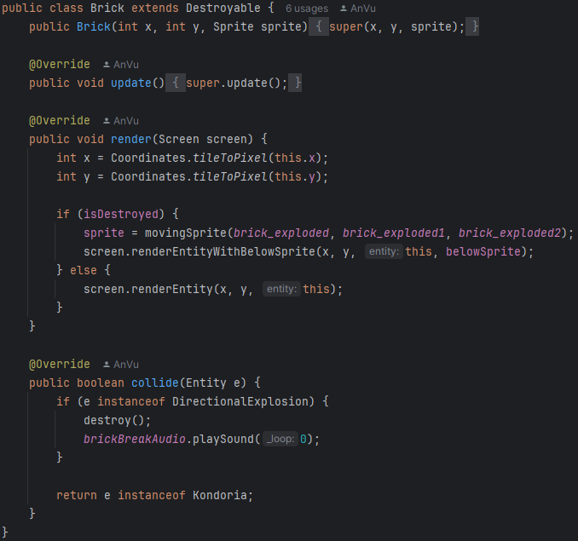
Brick belongs to the group of obstacles that can be destroyed only when the user places a bomb that satisfies the if(isDestroyed) condition. They will then check whether the collision is true or false, if so, this will satisfy this condition

Slide 38
entities/tile/destroyable/Destroyable

Slide 39
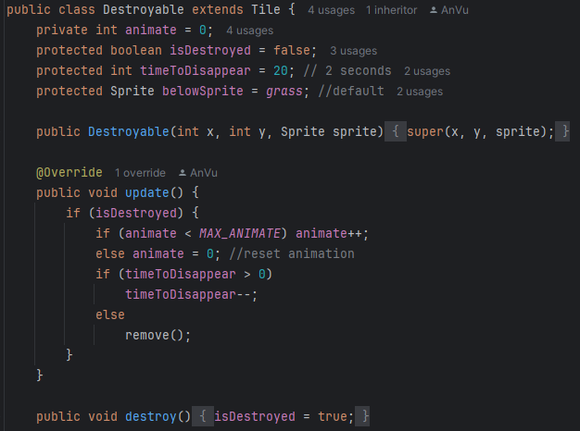
The destructible class allows evaluating whether an object can be destroyed or not. They will update and render if isDestroy = true. Then the effects related to the destroy class will occur within a certain period of time. It's important that they don't affect the sprite grass layer.

Slide 40
entities/tile/power/Power

Slide 41
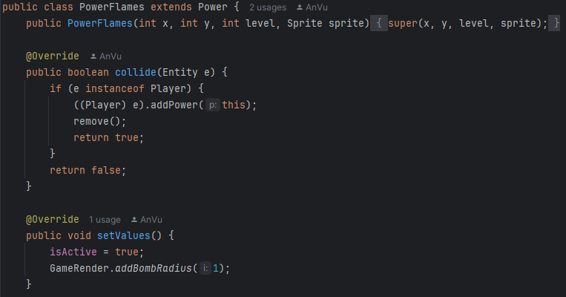
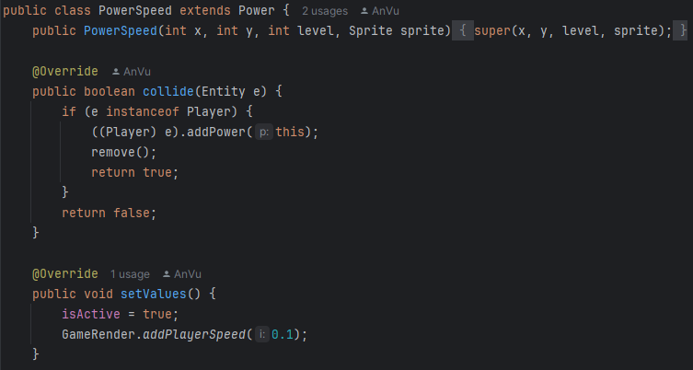
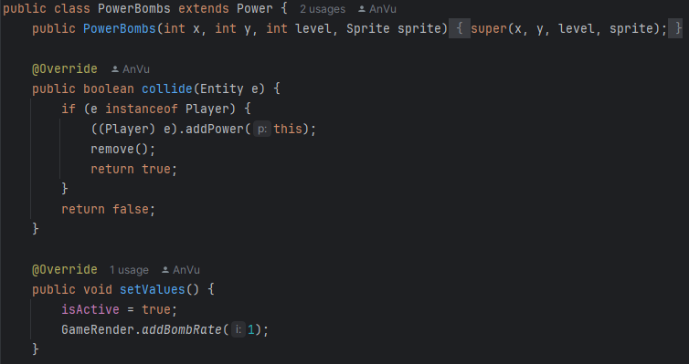


Slide 42
Graphic
IRender
SpriteSheet
Screen
Outlines the two essential methods that any class implementing this interface must define
The Screen class in the Bomberman game handles the rendering of game graphics and entities. It provides methods for drawing various game elements on the screen.
Sprite
This class handles extracting specific sprites from a sprite sheet and provides utility methods for sprite animation.
This class reads the image and extracts pixel data, which can be used by the Sprite class to render specific parts of the sheet.

Slide 43
graphic/IRender

Slide 44
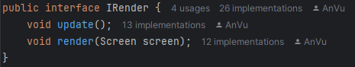
graphic/IRender
Any class that implements must include update() and render() functions.

Slide 45
graphic/Screen

Slide 46
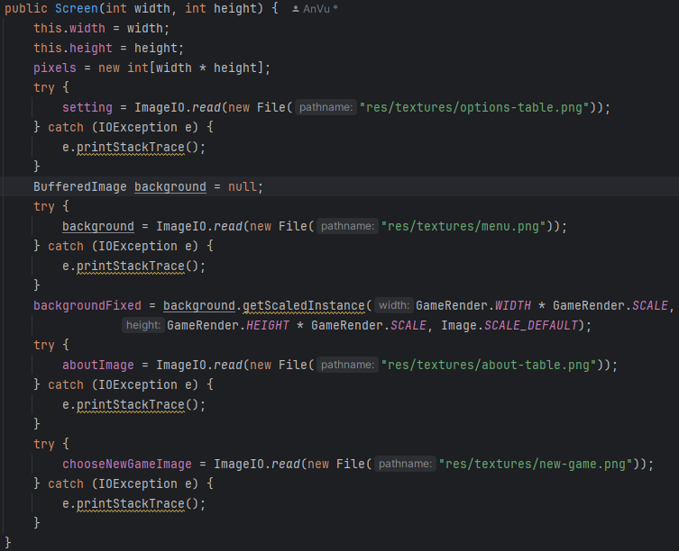
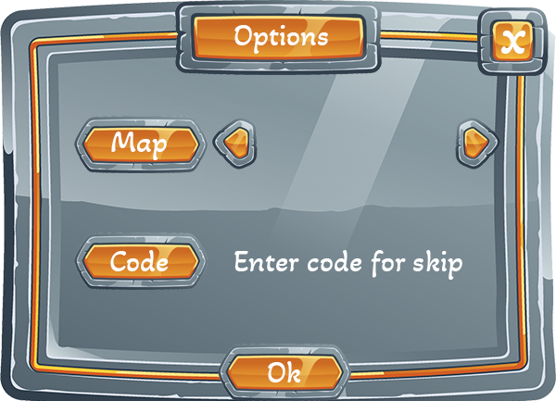
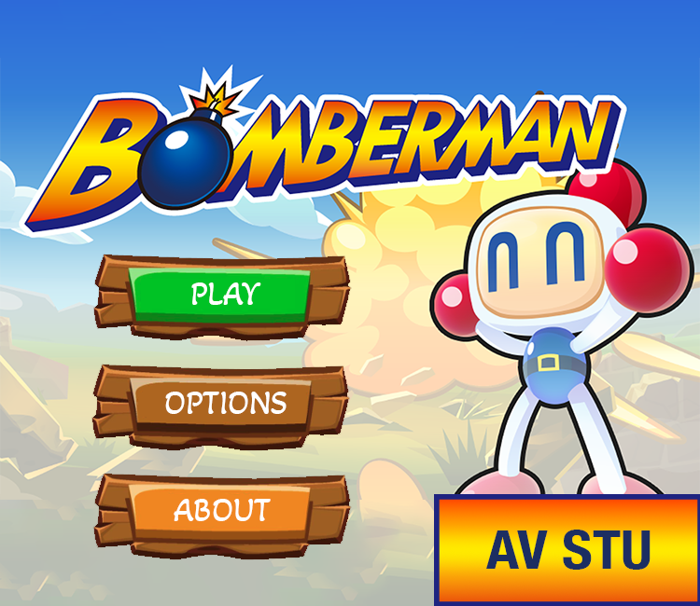
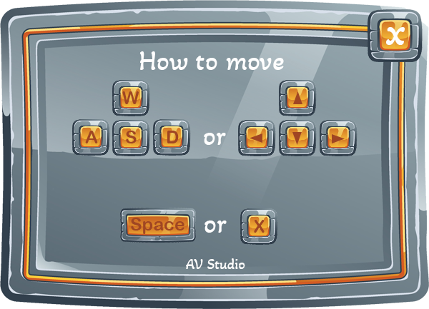


Slide 47
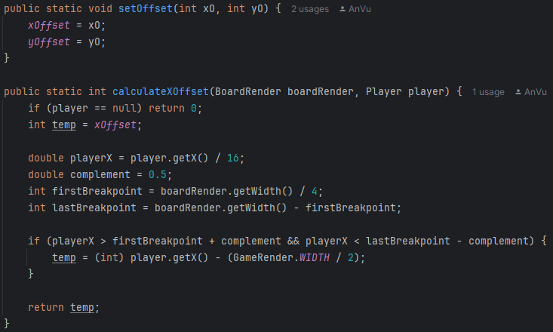
graphic/Screen
Calculate offset. This happens when the player moves to the other direction of the map. Because the map can only render to a certain length, when the player moves beyond the frame, the game will automatically move with the player to ensure the integrity of the frame.

Slide 48
graphic/Sprite

Slide 49
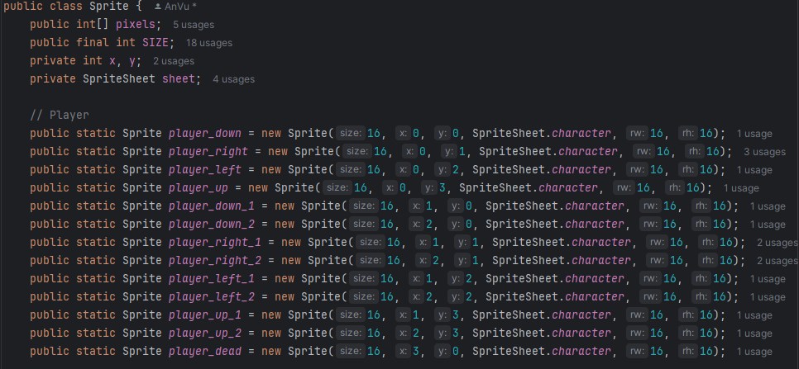

graphic/Sprite

Slide 50
GUI
CodePanel
GamePanel
Frame
GUI component that allows players to enter a code, typically used for navigating to specific game levels.
This class sets up the GUI by combining the game area (GamePanel) and the information display (Info)
Info.java
Extends JPanel and provides various UI elements such as labels and buttons for showing game statistics and for controlling certain game actions.
Extends JPanel and is responsible for displaying the game's content using the GameRender class, which manages the rendering process.

Slide 51
gui/CodePanel

Slide 52
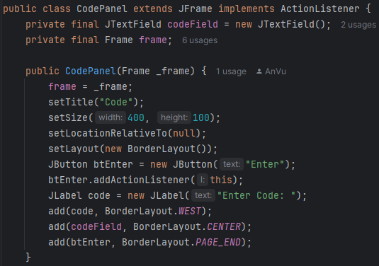
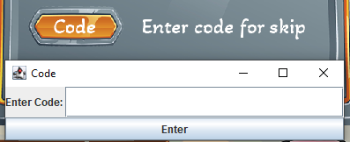
gui/CodePanel

Slide 53
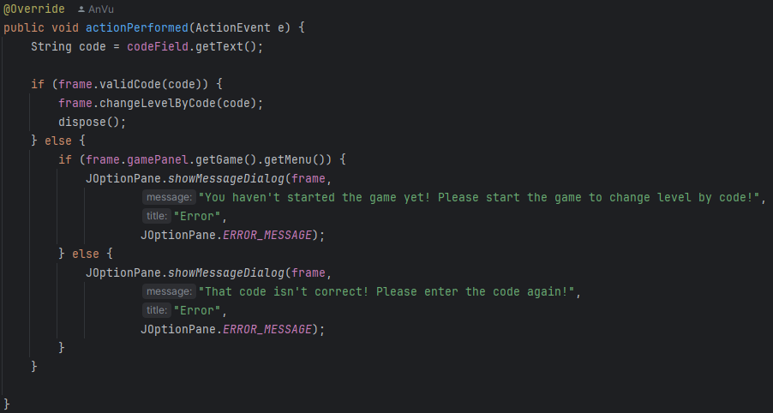
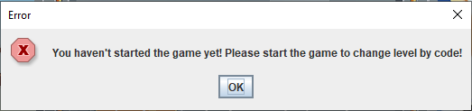
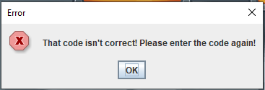
gui/CodePanel

Slide 54
gui/Frame

Slide 55
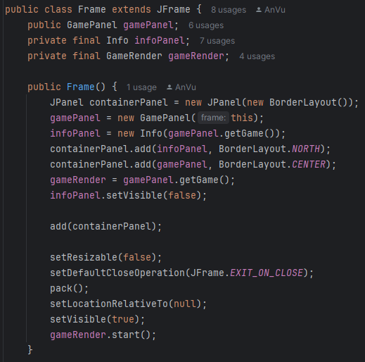
gui/Frame

Slide 56
gui/GamePanel

Slide 57
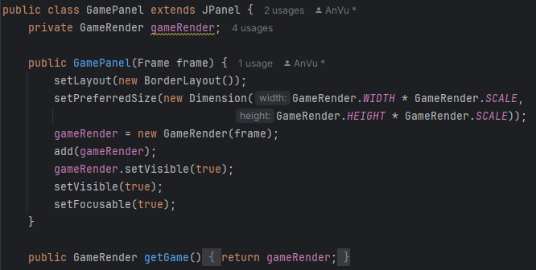
gui/GamePanel

Slide 58
gui/Info.java/FixedStateButtonModel

Slide 59
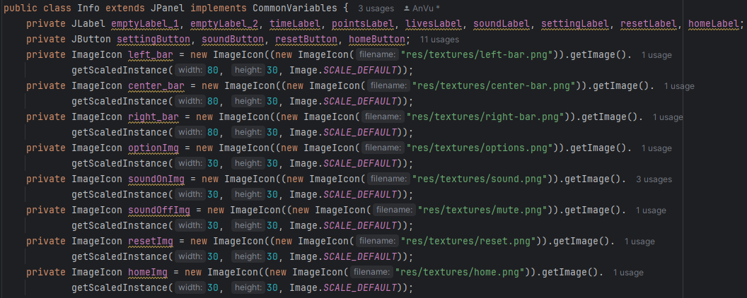
gui/Info.java/FixedStateButtonModel

Slide 60
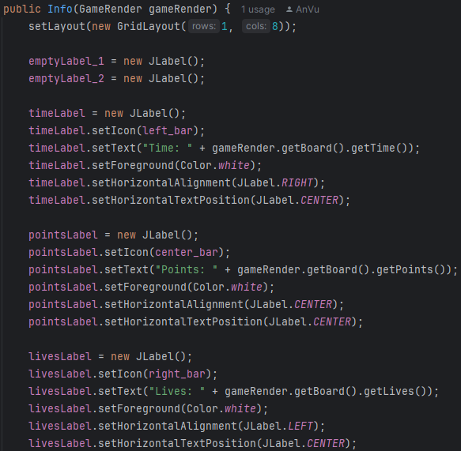
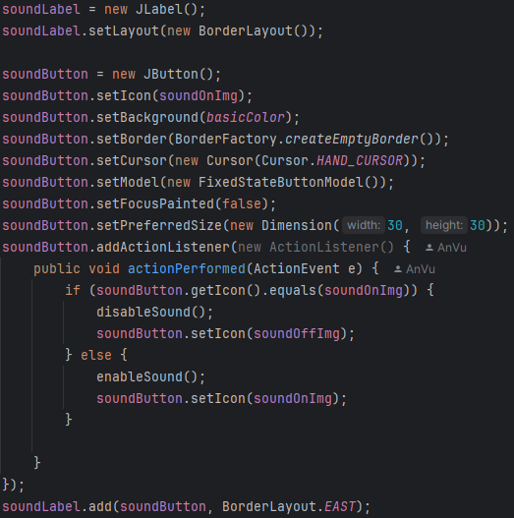

Slide 61
input/Keyboard

Slide 62
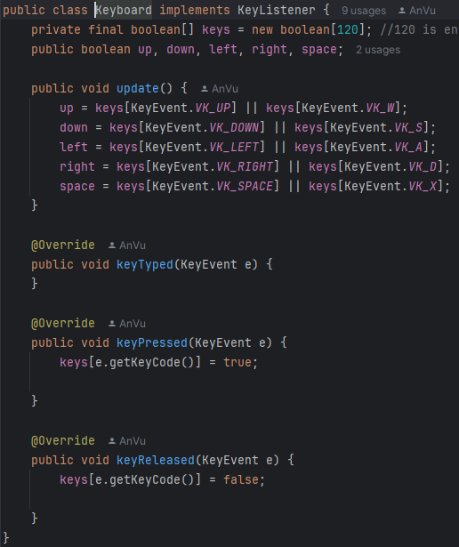
input/Keyboard
Only 5 actions, move up, move down, move left, move right and space - bomb
update() when key up or w; Key down or S; Key right for D; Key left for A .
Check when key is pressed or released

Slide 63
jdbc/ConnectJDBC

Slide 64
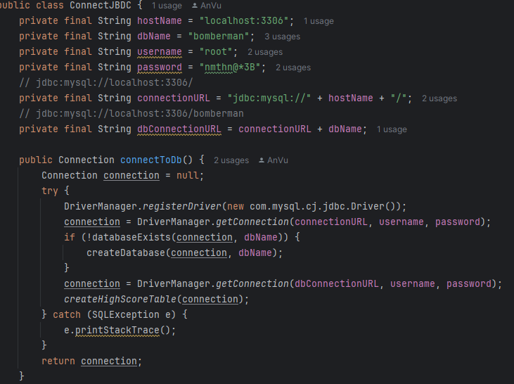
jdbc/ConnectJDBC
First I need to declare the database in MySQL, then create the connectionToDb() function and register the driver through the JDBC library (mysql-connector-j-9.1.0.jar)

Slide 65
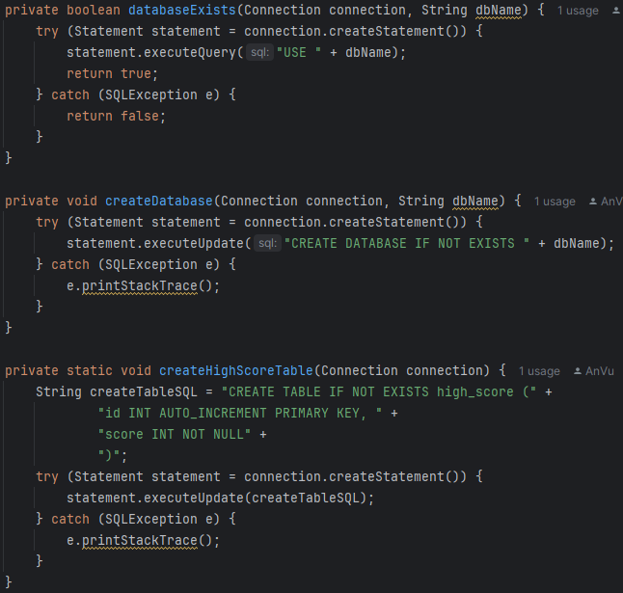
jdbc/ConnectJDBC
We will create automatic database creation functions, first checking to see if a database exists. If not, create a new database and transmit HighScore into the database.
This makes it more convenient for us during the database creation process. Instead of having to define in MySQL workbench, we can create it automatically through code

Slide 66
level/Coordinates

Slide 67
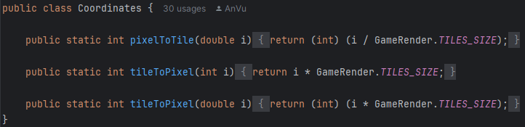
level/Coordinates
The Coordinates class facilitates mapping between the logical grid (tile-based) and the physical screen (pixel-based). This is essential in games like Bomberman, where the player, enemies, bombs, and other objects move within a grid-based level.

Slide 68
level/FileLevel

Slide 69
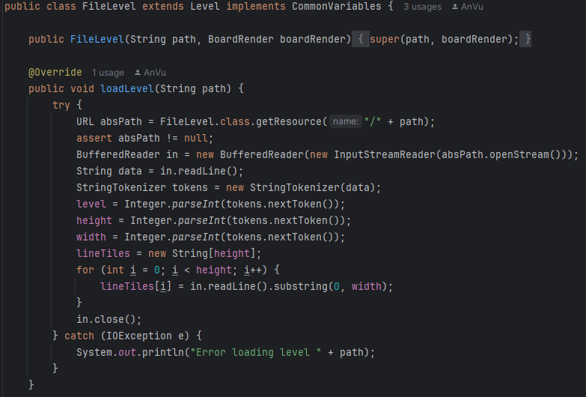
level/FileLevel
FileLevel reads and parses the map layout, setting up the game entities according to the specifications provided in the file. This allows for easy creation and modification of game levels without changing the code, making it flexible for designing various stages of the game.

Slide 70
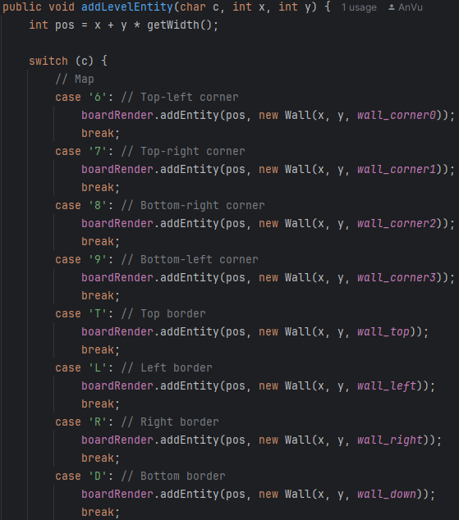

fevel/FileLevel

Slide 71
level/Level

Slide 72


level/Ievel

Slide 73
BoardRender

Slide 74

BoardRender
Responsible for managing and rendering the game board's state in the Bomberman game.
It handles the game's level, entities (such as characters and bombs), updates, and rendering logic, and also provides various game controls like pausing, restarting, and changing levels.
It implements the IRender interface, which means it is responsible for rendering the visual elements of the game.

Slide 75


BoardRender

Slide 76
CommonVariables

Slide 77


CommonVariables
Basic gameplay deliverables: the amount of bomb, bomb radius, and player speed are ate default
Player have 200 seconds to comple 1 level, starting point will be 0 and has only 3 lives

Slide 78



Each characters or entities have their own audio and image

Slide 79
GameRender

Slide 80


GameRender
Use 3 multi-threads for menu rendering, game rendering and UI update rendering.
Avoid wasting machine resources. Ensures stability when playing games without taking up too much memory.

Slide 81


GameRender

Slide 82



GameRender

Slide 83
Bomberman - main

Slide 84

Bomberman

Slide 85
03
Result
The completion of Bomberman project

Slide 86

Result
Bomberman
A fully playable game is the final product of the Bomberman gaming project
Interfaces, sounds, effects, in-game character interactions, bomb planting, barrier destruction, and engagement with enemies are all available to players.

Slide 87
Result
Bomberman
Using algorithms to suit the AI in the game. Through iterative testing, essential features—such as competitor AI and graphical responsiveness—have been improved
By putting BFS into practice, opponents have been able to move efficiently, chase players through the fastest path, and react quickly to barriers.

Slide 88
Result
Bomberman
Multi-threaded programming: Using 3 threads for Menu, game, and UI update
Meta-programming: Standardized methods for different game aspects, enabling flexibility in game growth and modification
GUI development with Swing: Interface was designed using Java Swing
Functional Programming: Effectively manage data processing and repetitive operations
JDBC: Store player scores via JDBC

Slide 89

Result

Slide 90
04
Conclusion
Summary project and discuss

Slide 91
Summary and Discussion
The Bomberman project was an interesting and demainding experience that improved the understanding of the Java programming concepts
Gained knowledge about effective code organization, handling unforseen testing situations, and performance optimization.
90% of the requirement have been completed, which are multi-threaded, meta-programming, GUI development with Swing, Functional Programming, and JDBC.
Potential:
Using network programming to let 2 players play online
Improve graphical user interface by using JAVAFX framework.
Optimization in coding to make it more clearly
More types of enemies, play-mode, power-ups, etc,.

Slide 92
05
Q&A

Slide 93
THANK YOU FOR WATCHING!

